Slide 1
Planning to go on a Ski Trip

Slide 2
Planning to go on a Ski Trip
Tanika Lucas-Clay
Kristan Clark
Wenting Hu
Michael Mccane

Slide 3
Table of Contents
Getting Started 4
Planning to go 5
Picking a Resort 6
Ski Gear 7
Ski Safety Tips 8
Preparing your Body 9
Preparation 10
Ski Wear 11
Keep warm 12
Buddy System 13
Learning how to Ski 14
Preparing to Ski 15
Put on your Skis 16
Basic Skills 17
Starting to Ski 18
Ski Movement 19
Trial Difficulty 20
Techniques 21

Slide 4
Getting Started
When planning to go skiing there are certain precaution to keep in mind. This Guide will help you have a safe and successful vacation!

Slide 5
Planning to go
When to go?
Reservations
Ski season: The ski season runs roughly from the end of November to the end of April. The busiest and most expensive times are around New Years and around Easter and in February; but the best time for beginners is January.
Decide a month in advance where you want to stay and make reservations to that resort.

Slide 6
Picking a Resort
When picking a ski resort there are a few things to keep in mind such as: Prices, restaurant locations, and entertainment.
Prices- When choosing a place to stay keep in mind the budget that you want to stay within not limiting yourself to expensive condos on the resort but also more affordable hotels in town.
Dining- Keep in mind when choosing a location to be sure that there are restaurants that will enjoy and affordable near by.
Nightlife- If you take interest in an exciting nightlife consider the bar/club locations near by the location you choose.

Slide 7
Ski gear
When planning to go skiing you should consider dressing in layers.
Base Layer- Thermal Body Shirt, Thermal Pants, and Ski Socks.
Second Layer- Fleece Jackets or Sweater, Ski Pants, and Ski Boots.
Finishing the Basics- Ski Helmets, Ski Hat, or Beanie, Ski Goggles, Ski Jacket, Skis, Ski Bindings, Ski Gloves, and Ski Poles.
Tip: Consider wearing Gore-Tex which is a waterproof and breathable fabric. It will work as an insulation keeping you warm and dry.

Slide 8
Ski Safety Tips
Some ski safety tips are:
Exercise in advance
Stay Hydrated
Use proper ski equipment
Get proper instruction
Wear a helmet
Wear goggles
Wear Gloves
Prepare for the weather
Take a break
Ski with a friend

Slide 9
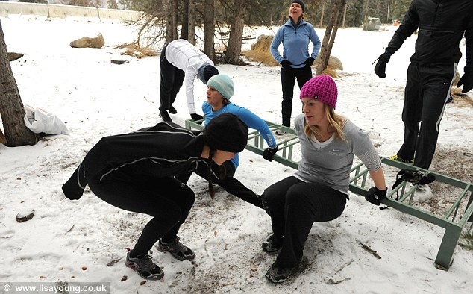
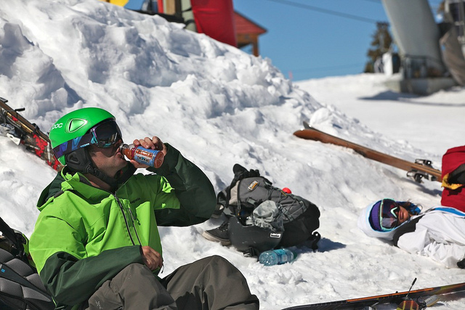
Preparing your body
Exercise in Advance
Stay Hydrated
Keep in mind that skiing is physically demanding you’ll want to be in shape to avoid injury.
Drink lots of fluids because even though it’s cold you can sweat excessively due to insulated clothing.

Slide 10
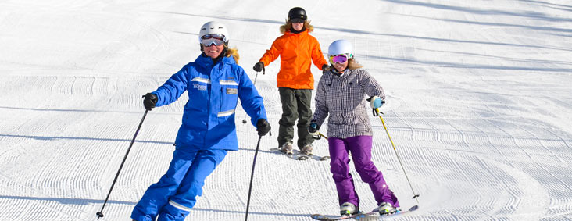
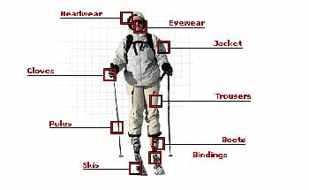
Preparation
Use proper ski equipment
Use proper instructions
Try not to borrow equipment. Rent from a ski shop or the ski resort. When buying equipment, make sure your ski boots are fitted properly. In both cases, make sure your bindings are properly adjusted.
If you are a beginner try to sign up for ski lessons and if you haven't skied in a while it doesn’t hurt to refresh.

Slide 11
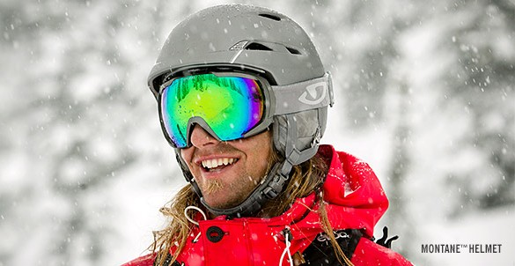
Ski Wear
Wear a Helmet
Wear Googles
Wearing protective headgear while skiing makes good sense. The most important tip I would offer to all parents and guardians ¬is to give a child no choice but to wear a helmet.
Wear ski goggles that fit properly around your helmet. If you wear eyeglasses, buy goggles that fit comfortably over your eyeglasses or consider prescription goggles.

Slide 12
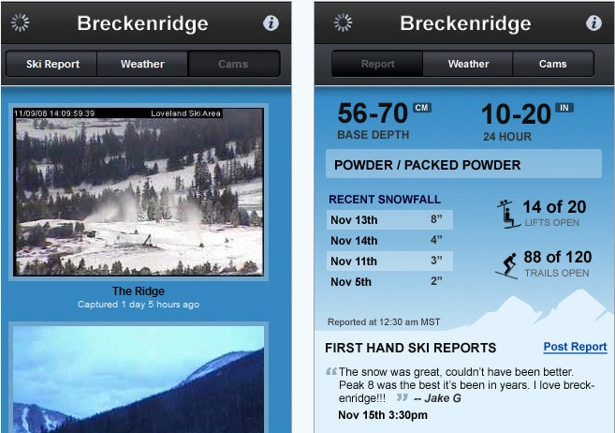
Keep Warm
Prepare for the Weather
Wear Gloves
Wear layers of clothes and wear a helmet liner, a hat, or a headband. Wear gloves or mittens. Bring an extra pair in case the first pair gets wet.
Make sure you have waterproof gloves so your hands can stay warms.

Slide 13
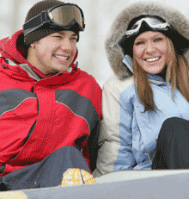
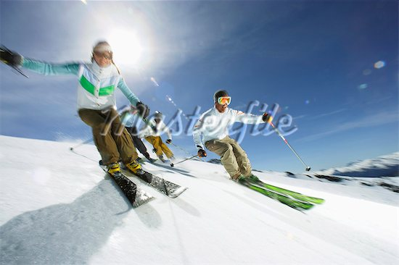
Buddy System
Take a break
Ski with a friend
If you're tired, take a break and rest for a while in the lodge. While you're resting, make sure you eat and drink enough. Skiing burns a lot of energy!
It's always safer to ski with a friend so he or she can watch out for you and vice versa. Prearrange a meeting place in case you get separated.

Slide 14
Learning how to Ski
Take lessons
Put on your ski boots
Put on your skis
Assume the basic skiing posture
Learn how to walk in skis
Start on the bunny hill
Ready yourself at the top
Learn how to turn
Move on the rest of the ski hill
Learn how to distinguish trail difficulty
Start with your first beginner trail
Try skiing without using the “pizza technique.”
Try your first intermediate trail

Slide 15
Preparing to Ski
Take Lessons:
Although this may not be a first option for everyone, since they can be expensive and sometimes aren't fun, it is arguably the fastest way to get the basics down. Look for beginners' classes that are offered in skiing resorts and mountains.
Put on your ski boots:
You'll need to find the right size and adjust the tightness. At rest, your foot should be essentially immobile but not compressed. Your toes should not press against the front of the boot when you bend your knees to point your shins slightly forward at the angle of the boot. The top of the boot should be snug around your ankle.

Slide 16
Put on your skis
Put on your Skis: . If your skis are locked together, bottom-to-bottom, by the clip-like "snow brakes" extending from the bindings past the flat sides (their purpose is to keep the skis from running away when they pop off the boots to protect your feet from excessive twisting), set the skis upright on their back end, hold down the one with its brake "inside", and gently shake and wiggle off the one with its brake "outside".
Set the skis pointing in the same direction about a foot apart. Stick the poles in the snow on each side of the skis, a few inches to the side and next to the front edge of the binding. Hold onto the poles and, one foot at a time, tuck the flange at the boot's toe into the front binding and then push the flange at the boot's heel into the rear binding, which should close with a click.
Slide each foot back and forth a little to check that the ski has attached. If it hasn't, try again. To take off a ski, or to reset its latch to retry a failed mounting, push down the lever behind the boot to be parallel to the ski. This is most easily pushed with a pole, by putting the spike into the indention.

Slide 17
Basic Skills
Assume the basic skiing posture:
Bend your knees so your shins rest on the front of the boots and also lean forward slightly. The length of the skis will make falling forward unlikely. Leaning back will not normally stop you, but will make the skis hard to control. Put your hands through the straps on the ski poles and hold the poles by your sides. During most actual skiing, you'll want them ready to use, but won't actually use them.
Learn how to walk in skis:
One of the first things you should learn is how to move around in skis. There are a few methods: Keep the skis parallel and push yourself forward with the poles. With both arms simultaneously, stab the poles, angled gently rearward, into the snow beside you, rotate your entire arms smoothly backward, and repeat. The angle lets you use your stronger shoulder muscles rather than your weaker forearm muscles to pull back. Pull one side more than the other to turn.

Slide 18
Starting to ski
Start on the bunny hill:
Start on the bunny hill. A bunny hill is defined as a small slope, preferably with a rope tow. Go up the carpet lift, rope tow or chairlift to the top of the bunny hill. A carpet lift is a big conveyor belt. In one arrangement, you push yourself forward onto the leading edge, ride it most of the way with your poles on the belt, ready to brace yourself on them against a sudden stop usually caused by a child's or beginner's error. Several feet from the end, lift your poles to avoid jamming the end mechanism and lean gently forward to smoothly ski to a halt off the end of it.
Ready yourself at the top:
Watch out for others, especially if the bunny slope is at the foot of another slope from which other skiers may come in fast. First, familiarize yourself with the technique for stopping or slowing down: point your skis together, then push your heels out to form a wedge with an open point and the leading sides tilted slightly up into the oncoming snow. This is known as the "pizza", "wedge", or "snowplow" after an old-fashioned wedge-shaped plow[6]. The wider you spread it, the slower you go. Do not overlap your skis: that tends to lose to a loss of control. Allow yourself to begin sliding down the slope, but go slowly. Keep your skis pointed together. Once you reach the bottom, point the skis toward each other and make a wide angle. This will stop you fairly quickly. If you fall, point the skis so they point across the slope, not down it. Push yourself up, orient yourself, and continue down the slope.

Slide 19
Ski movement
Learn how to turn:
After you have done the bunny hill a few times, you will likely begin to want to turn. To do this, shift your weight onto the ski that is not in the direction you want to turn. Pushing against it tends to swing your body sideways behind it so that it continues, now at an angle cutting against the snow, in front of you. Lean into and dig the ski edges into a turn a little to make it sharper. Plan ahead: curves will be wide at first. Give obstacles plenty of space! Once you know how to do this, you can go down the hill in a curved kind of zigzag.
Move on the rest of the ski hill:
Once you have mastered the bunny hill -- that is, you can ride the lift, walk on the flat part, ski down, turn both ways and stop with ease -- you should be ready to try a beginner hill. Consult with your instructor. See if he or she thinks you are ready, and then get ready for the rest of the mountain!

Slide 20
Trail Difficulty
Learn how to distinguish trail difficulty:
You can tell how hard a trail is by the symbol on the trail marker or ski map. In North America, trail difficulty is indicated as follows: A green circle indicates an easy, or beginner, trail. These trails are not too fast, will contain few obstacles, and aren't too long.
Start with your first beginner trail:
Consult the ski map to find a suitable trail. It should be close to the base area. Try to find a green run that starts at the top of a lift and ends at the base area, or a series of trails like so that are all green. Ride up the lift, and start on the trail.

Slide 21
Techniques
Try skiing without using the “pizza technique.”:
As you go down more runs, you should learn to ski without using the technique that keeps you moving slowly. Once you become accustomed to skiing the green trails, try putting your skis parallel to each other for parts of the slope. Parallel skiing will cause you to go faster. Instead of going back into pizza turn across the mountain to control your speed.
Try your first intermediate trail:
Before selecting a trail, make sure you know how to turn and stop. These skills will be very important. Select a trail that starts at the top of a lift and ends at the base area, or select a path made up of blue and green trails. While going down the intermediate trail, you may notice it is steeper and you will probably wipe out a little more. Don't worry about this. With practice, these trails will become easier and easier.

Slide 22
Troubleshooting Guide
FAQ
Answers
1. Where can I get lift tickets?
2. Where is the best ski school?
3. Do you offer night skiing
4. Where do I park when going to ski?
5. Is there different transportations?
6. Do any ski resorts offer tubing or sledding?
7. Where can you rent skis?
1. You can always get your lift tickets when you get to the mountain you want to go to. Also, ask your resort for any discounts that may be available.
2. You can get information about ski schools at your resort or you can always ask at the ski rental place or at the mountain where you buy your lift tickets.
3. Some mountains offer night skiing. You just need to check with the mountain on their closing times.
4. Every mountain has places for skiers to park. Usually you can park at the bottom and have a shuttle pick you up and take you to the top of the mountain.
5. There are a few different transportations to get to the mountain. For example, the shuttle, Gondola, and mountain parking.
6. Some ski resorts offer tubing or sledding, it just depends on where you go. You can always ask your resort if they offer it or a place nearby that does, if the resort does not.
7. Anywhere you go to ski; there will be rental places to rent skis or snowboard, which ever you prefer. You might want to call around or research and see who has the lowest prices.

Slide 23
Index
Basic Skills 17
Buddy System 13
Getting Started 4
Keep Warm 12
Learning How to Ski 14
Planning to go Ski 5
Picking a Resort 6
Preparing to Ski 15
Preparing Your Body 9
Preparation 10
Put on Your Skis 16
Ski Gear 7
Ski Movement 19
Ski Safety Tips 8
Ski Wear 11
Starting to Ski 18
Table Contents 3
Techniques 21
Trial Difficulties 20

